Slide 1
Spatial Decision Support for Assessing Impacts of Atmospheric Sulfur Deposition on Aquatic Ecosystems in the Southern Appalachian Region
Keith Reynolds, Paul Hessburg, Nicholas Povak, and Brion Salter
USDA-Forest Service, Pacific Northwest Research Station, Wenatchee, WA and Corvallis, OR Tim Sullivan and Todd McDonnell
E&S Environmental Chemistry, Corvallis, OR

Slide 2
Overview
Post-hoc niche modeling effort to predict continuous ANC and BCw surfaces from training data
933 sites had measured stream water chemistry, ANC values
140 sites had modeled BCw values via MAGIC process model
BCw + ANC used to estimate CLs of atmospheric S deposition
We present a logic-based model for assessing aquatic impacts of S deposition based on modeled stream ANC and CL exceedance
We demonstrate the model in an SDS system, presenting results for the Great Smoky Mtn National Park

Slide 3
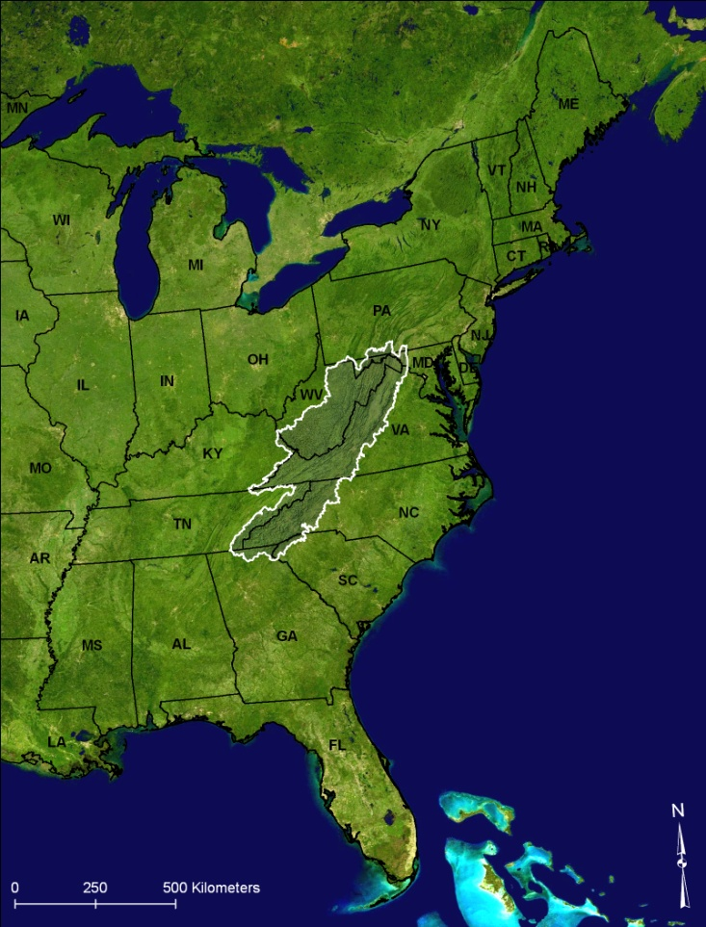
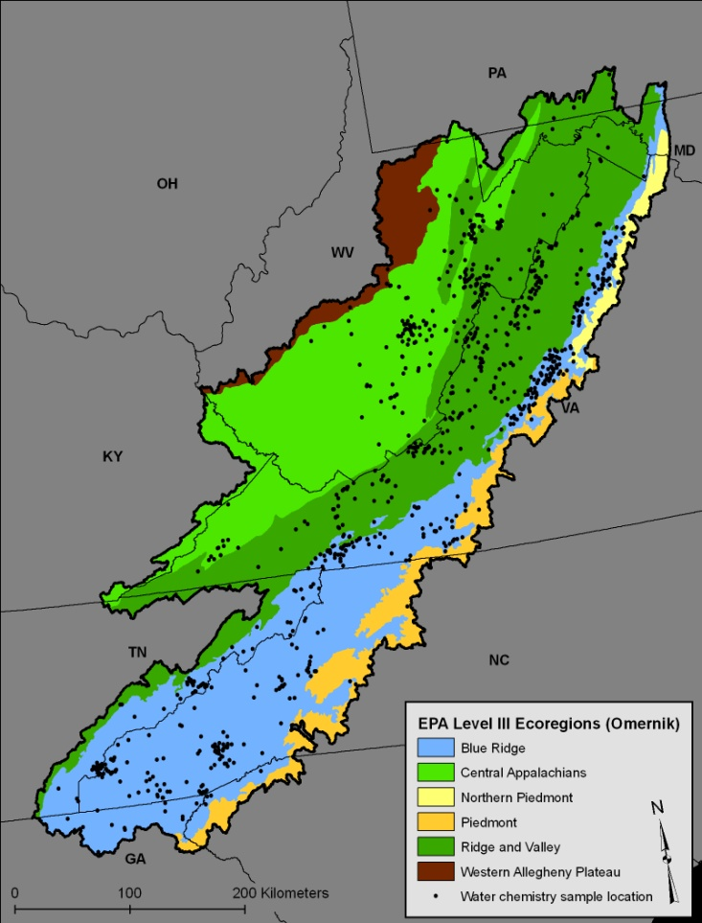
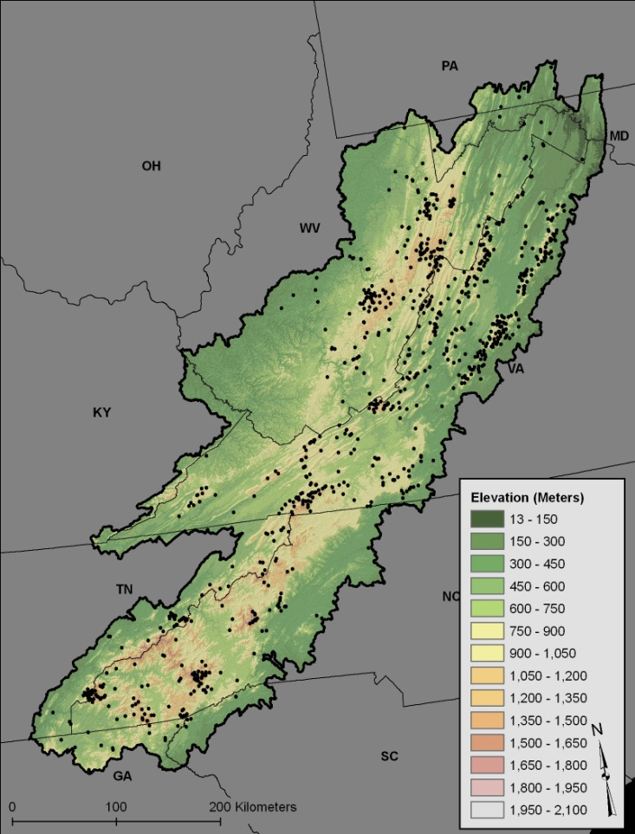
Study area
Study Area Size: 14.3 MM ha (35.4 MM ac)
Ecoregions: Ridge & Valley, C. Appalachian, Blue Ridge, Piedmont, No. Piedmont, W. Allegheny Plateau -- VA, WV, NC, SC, TN, KY, PA, MD, GA
Notes:
Primary ecoregions are Blue Ridge, Central Appalachians, and Ridge & valley

Slide 4
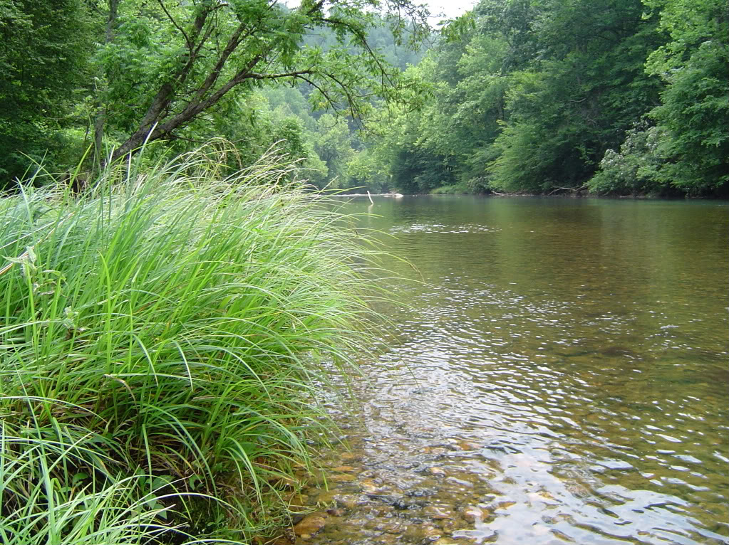
Niche modeling methods
56 initial predictors, including topo, soil, clim, lith, vegt, ownership & SO_{x} dep. vars (wet, dry, total)
Eliminated significant multi-collinearity → 33 vars
Submitted the 33 vars to randomForest (RF) modeling implemented within a hurdle modeling algorithm
Optimized model parsimony, prediction, error rate
Also compared RF models against OLS, logR, BCT, BRT
RF best at avoiding model overfitting
Data Sources: Ameriflux, PRISM, STATSGO, EPA-CMAQ, NED, NLCD2000, E&S Env Chem
Notes:
BCT, BRT, and RF are machine learning algorithms and ensemble versions of CART methods.
RF outputs a majority vote from a set of naïve trees.
RF uses bagging algorithm to select random samples of training data and predictors.

Slide 5
Hurdle model algorithm
Threshold model (tRF)
A binomial RF model that predicts whether a cell is above/below a specified threshold ANC (tested thresholds 150, 200, 250, 300 µeq∙L⁻¹)
Continuous model (cRF)
For all cells in which ANC was predicted below the threshold, data enter a RF model w/ a cutoff probability from the tRF to enter the continuous model.
Cutoff
Probability required for entrance into a cRF model, was varied from 0.4 (liberal) - 0.7 (conservative)
ANC Data
Predict ANC < 300
ANC >300 [STOP]
ANC < 300
Threshold ANC model (Binomial, Random Forest)
Predict ANC
Continuous ANC model (Random Forest)

Slide 6
Results “Well-buffered” “Poorly buffered”
 | tRF model vars | Import |  |  | cRF model vars | Import
 | % area carbonate lithology | 20.23 |  |  | % area siliceous lithology | 18.64
 | Soil pH | 12.20 |  |  | Max days w/o PCP while >10ºC | 11.98
 | VPD days <1000 Pa w/>10ºC | 12.08 |  |  | Mean GS days > 32.2ºC | 11.51
 | GS diurnal surface TMP diff | 10.68 |  |  | VPD days <1000 Pa w/>10ºC | 9.24
 | % area public ownership | 10.60 |  |  | Dry S deposition | 9.13
 | % area forest cover | 8.86 |  |  | % area forest cover | 8.79
 | % area argillic lithology | 7.14 |  |  | % area soil clay | 8.42
 | PCP sum during local non-GS | 6.83 |  |  | Soil pH | 7.99
 | Cont VPD days >750 Pa >10ºC | 6.17 |  |  | Topographic wetness index | 7.38
 | Non-GS GPP | 5.20 |  |  | Flow accumulation | 6.92
Data Sources: Ameriflux, PRISM, STATSGO, EPA-CMAQ, NED, NLCD2000, E&S Env Chem
GS=local growing season, Pa=pascals, TMP=temperature, VPD=vapor press deficit, PCP=precipitation, S=sulphur, GPP=gross primary productivity, Cont=continuous
Notes:
Relative importance is based on the mean increase in mean squared error (regression) and decrease in model accuracy (classification) when the variable was left out of the predictor set used to train the individual regression trees within the random forest model.

Slide 7
How we got to 10 predictors, cRF
RF
GBM
OLS
Optimized model parsimony, variance explained, minimized error
Notes:
Gbm is a statistical package for machine learning algorithms, and includes BCT and BRT methods.
BCT, BRT, and FR are ensemble versions of CART.
They all output a majority vote from a series of naïve trees.

Slide 8
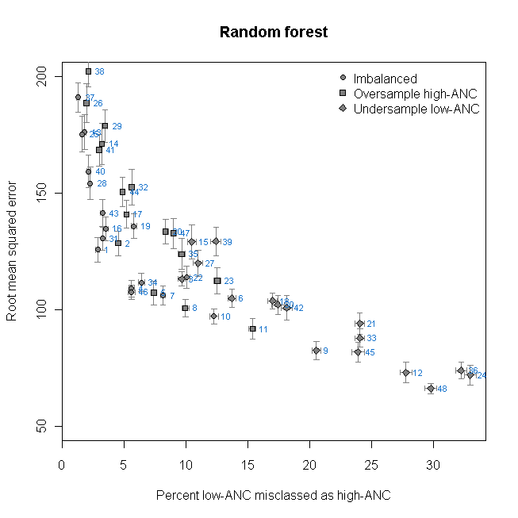
Scatterplot of cRF model performance
48 modeled* combinations of the data varying…
Sampling design (3) oversampled ANC_{hi} undersampled ANC_{low} imbalanced_{as is}
ANC threshold → cRF (4) [150, 200, 250, 300]
Cutoff probability → cRF (4) [0.4, 0.5, 0.6, 0.7]
* Whiskers represent the 95% CI
Notes:
Out of bag samples = training data left out while building an individual tree
Out of bag error rate computed for each sample
Results averaged over all samples to get RMSE

Slide 9
10 best performing cRF models
ID | Data sampling | ANC cutoff | Prob. cutoff | Misclass (%) | RMSE
1 | Imbalanced | 150 | 0.4 | 2.8 | 125.7
4 | Imbalanced | 150 | 0.5 | 5.6 | 109.1
7 | Imbalanced | 150 | 0.6 | 8.1 | 106.0
31 | Imbalanced | 250 | 0.6 | 3.2 | 130.5
34 | Imbalanced | 250 | 0.7 | 6.4 | 111.7
46* | Imbalanced | 300 | 0.7 | 5.6 | 107.5
2 | Oversampled | 150 | 0.4 | 4.5 | 128.5
8 | Oversampled | 150 | 0.6 | 9.9 | 100.7
5 | Oversampled | 150 | 0.5 | 7.4 | 107.2
3 | Undersampled | 150 | 0.4 | 9.6 | 113.2
Notes:
Out of bag samples = training data left out while building an individual tree
Out of bag error rate computed for each sample
Results averaged over all samples to get RMSE

Slide 10
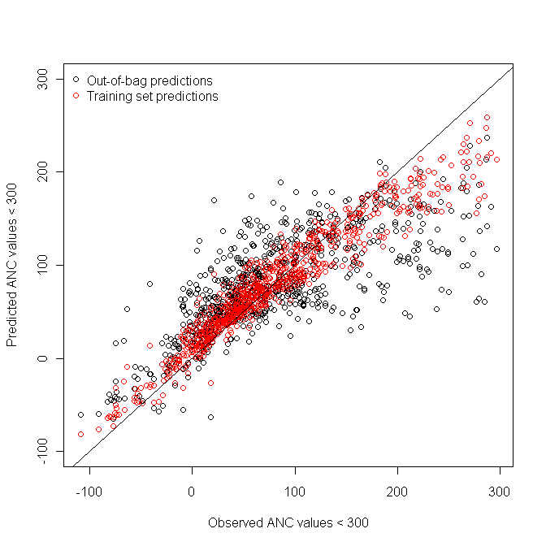
Continuous RF model performance, best model
Predicted vs. observed ANC
Red dots represent predictions made for the sampled data locations
The diagonal represents perfect correspondence btw observations and predictions

Slide 11
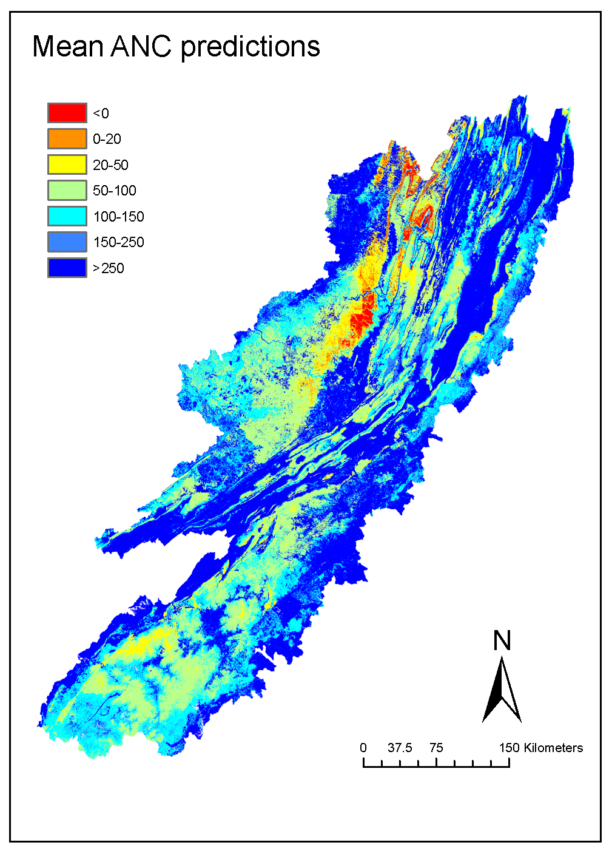
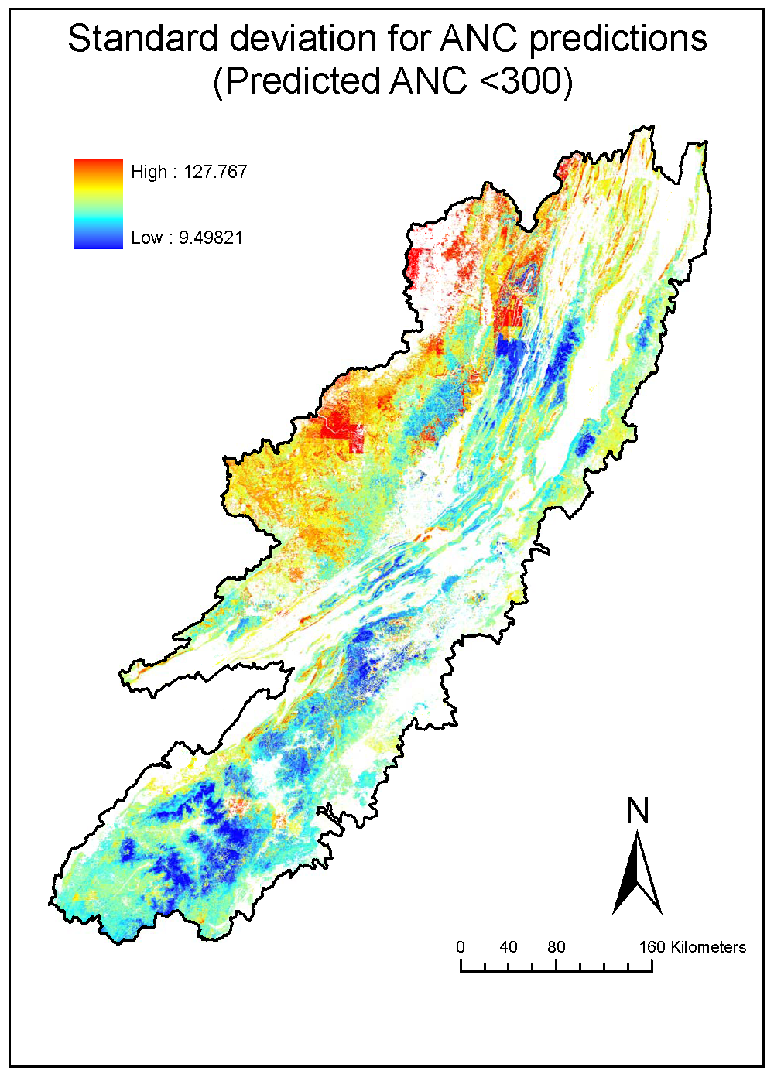
Predicted ANC
Model 46, imbalanced data, 0.7 cutoff probability, <300 µeq∙L⁻¹ ANC threshold
Mean ANC prediction based on 1,000 naïve regression trees.
ANC units are µeq∙L⁻¹ .
Note: We predicted ANC for 159 MM grid cells using 933 sampled cells;
Stream networks represented by 4MM cells, 1/40th, more tractable
Notes:
Naïve = randomly selected sets of predictors

Slide 12
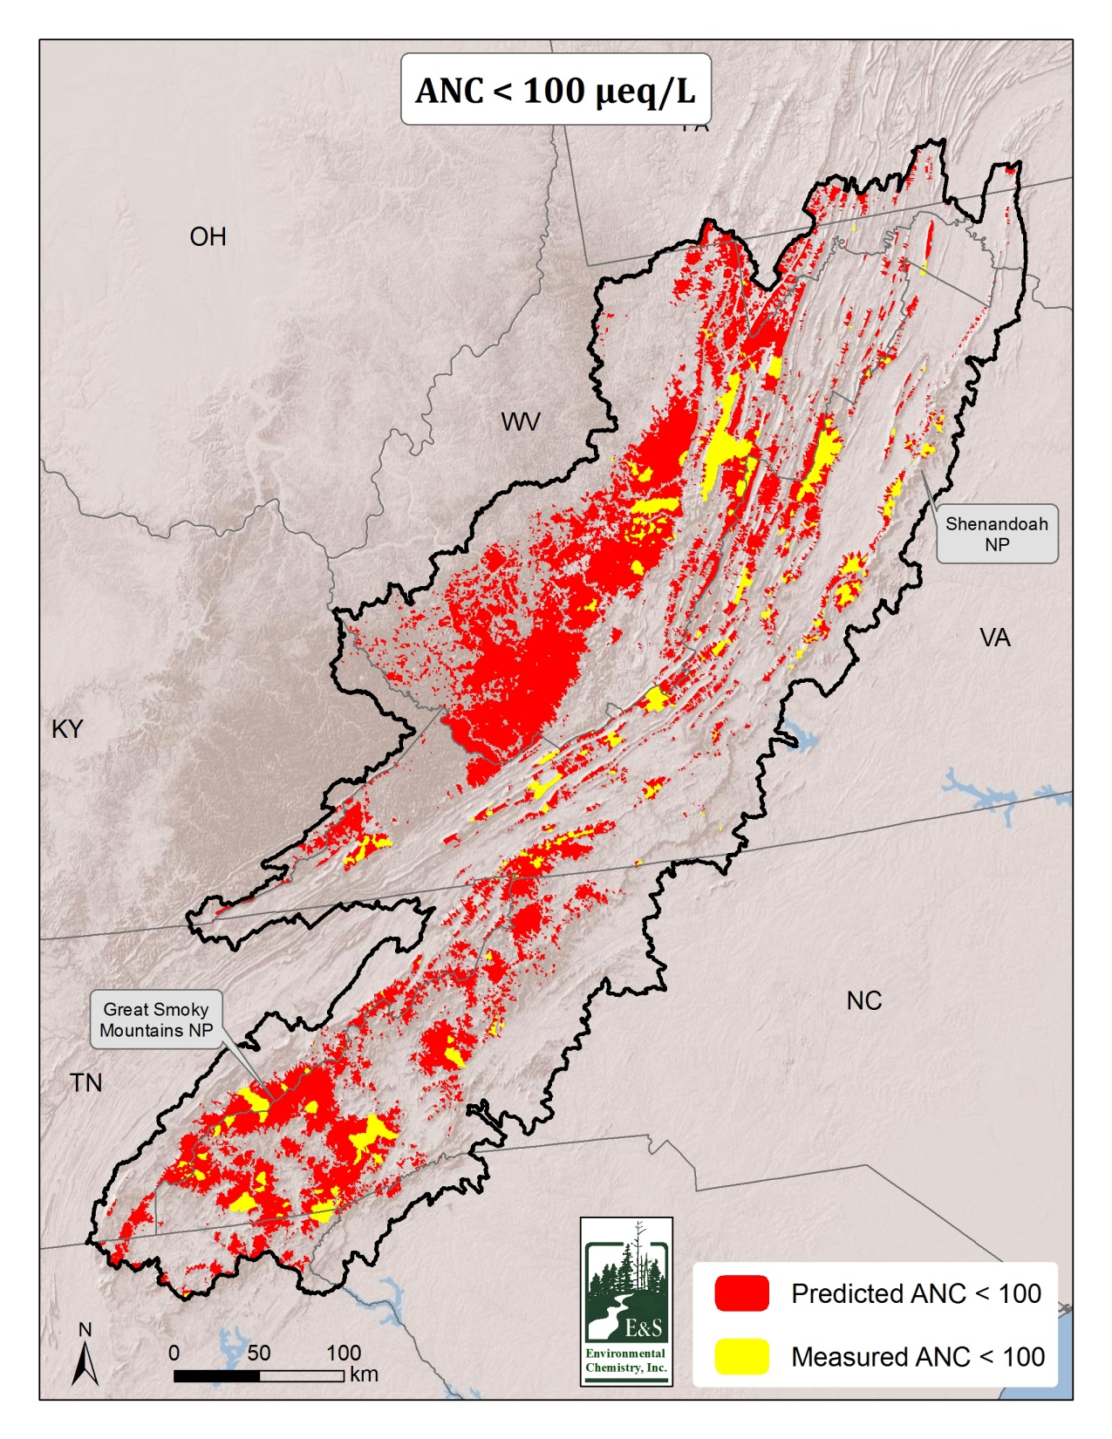

Slide 13
BCw Results
cRF vars | Import
S wet deposition | 14.75
Percent siliceous lithology | 14.33
Mean PCP sum during the non-GS | 10.79
Max days w/ PCP >0.3cm w/ TMP > 10ºC | 9.73
S dry deposition | 9.02
% area mixed conifer cover | 8.69
% area soil clay | 8.64
Mean soil organic matter to 50 cm depth | 8.56
GS diurnal surface TMP diff, non-GS | 8.29
Mean soil Kjeldahl N to 50 cm depth | 7.21
Data Sources: Ameriflux, PRISM, STATSGO, EPA-CMAQ, NED, NLCD2000, E&S Env Chem

Slide 14
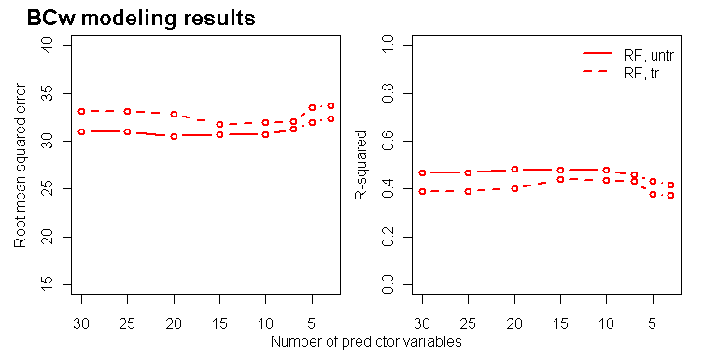
How we got to 10 BCw predictors, cRF
RF models developed using predictor vars in their native scales (untr=untransformed), and
w/ log-transformed BCw and standardized predictors (tr=transformed).

Slide 15
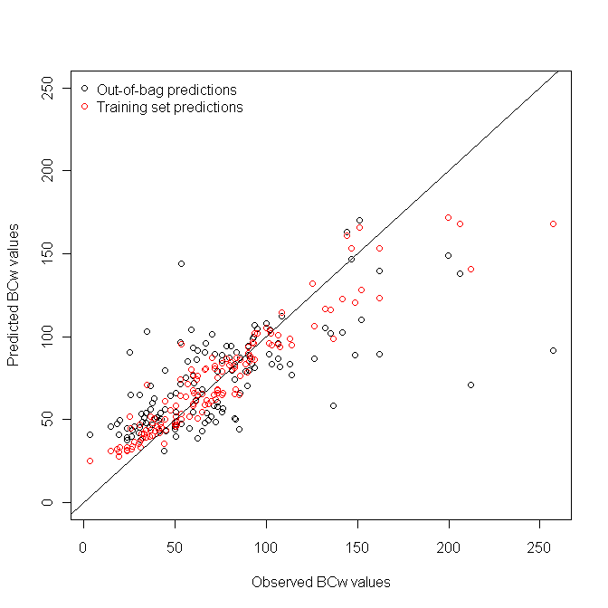
cRF model performance
Predicted vs. observed BCw
Red dots represent predictions made for the sampled data locations
The diagonal represents perfect correspondence btw observations and predictions

Slide 16
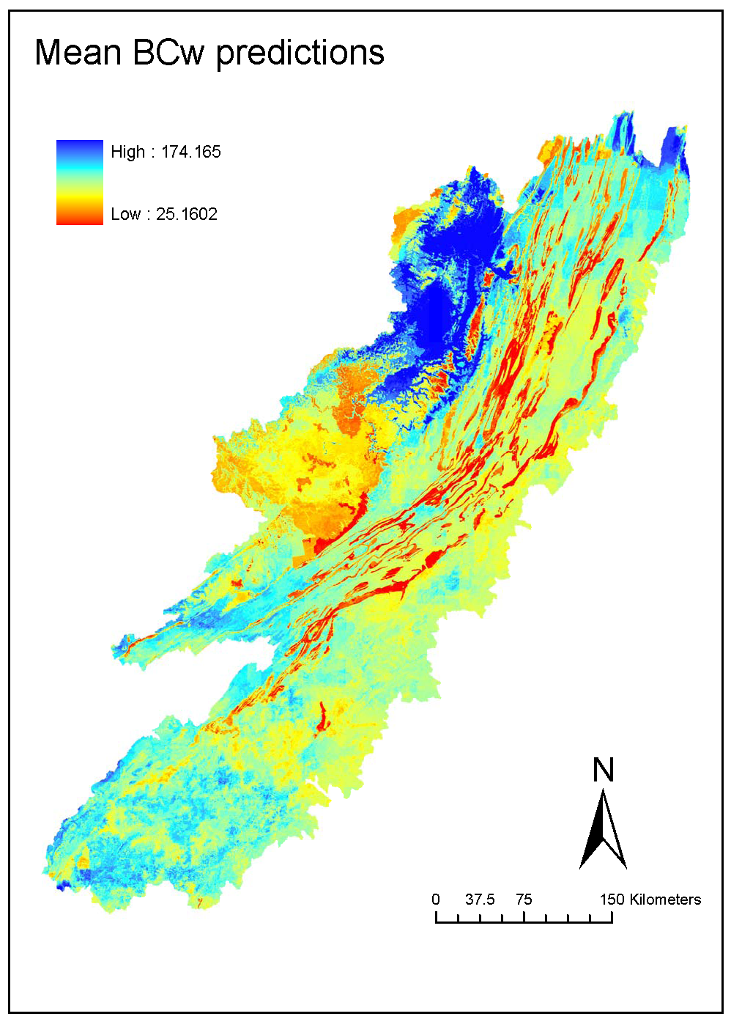
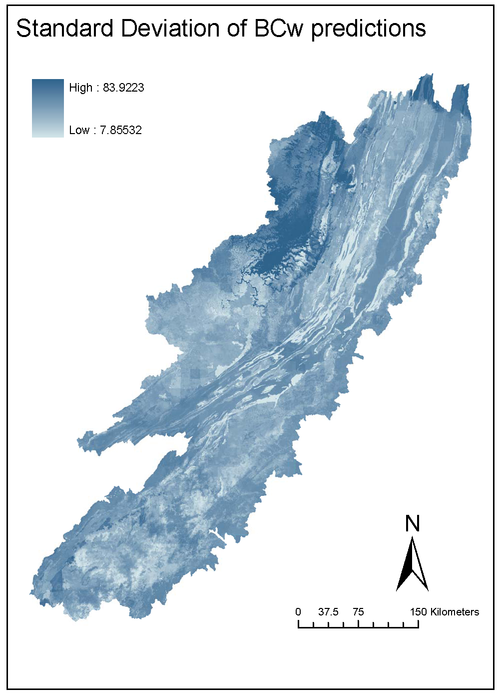
Predicted BCw
Mean BCw prediction based on 500 regression trees to derive the RF model.
Units are meq∙m⁻² ∙yr⁻¹.

Slide 17
Outline – inputs to logic
Biological response functions
Weighting the ANC predictions
Three methods for estimating BCw
Critical loads and Exceedance

Slide 18
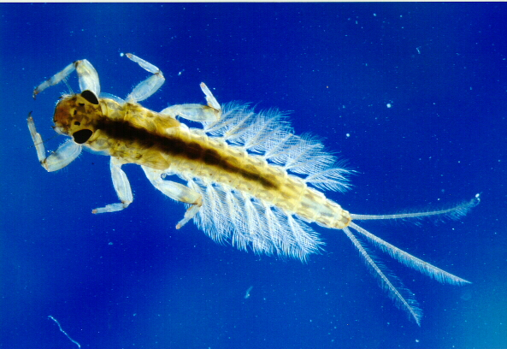
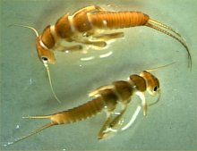
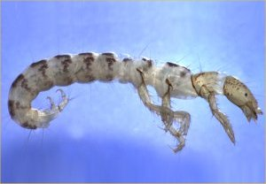
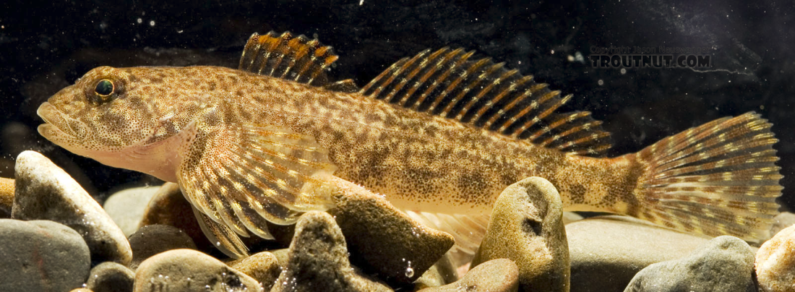
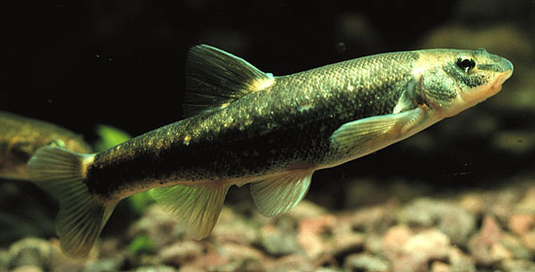
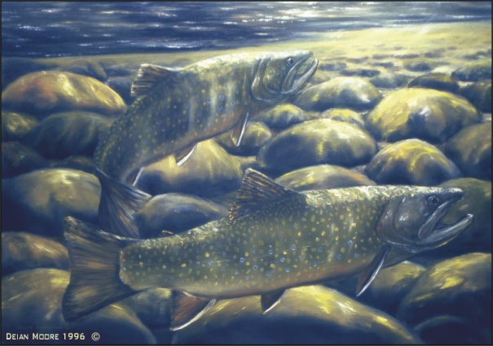
Biological Resources
Mayfly
Stonefly
Caddisfly
http://wiki.colby.edu/display/es398b/
Benthic+Macroinvertebrate+Testing
http://www.epa.gov/bioiweb1/html/stoneflies.html
http://www.epa.gov/bioiweb1/html/caddisflies.html
Sculpin
Dace
Brook Trout
http://www.troutnut.com/topic/724
Wikiimedia.com
Deian Moore
Notes:
The biological response functions in EMDS focus on macroinvertebrates (specifially, aquatic insects) and fish
Macroinvertebrate assemblages have been well established as indicators of water quality and are and imporant part of the food chain

Slide 19
Biological Response: Insect Richness
Modified from: Cosby et al. 2006
Notes:
Indicate the different responses from 0 to 50 and from 50 to 150
State that we chose 100 as our target in EMDS

Slide 20
Biological Response: Fish Richness
Modified from: Cosby et al. 2006
Notes:
We also chose ANC = 100 as our target for fish richness
It is not reasonable to expect that # of species continues to increase beyond ANC = 150,
We do not have enough data beyond

Slide 21
Biological Response: Fish Presence
Brook Trout
Sensitive Fish Species

Slide 22
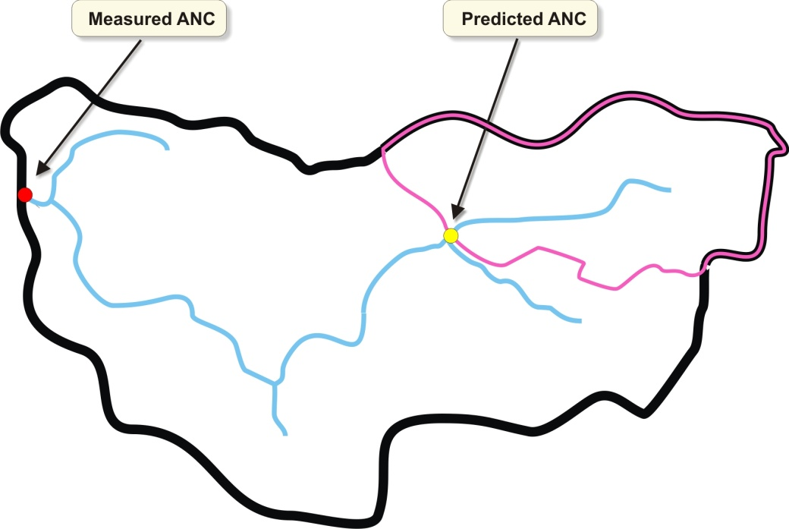
Weighting Predicted ANC
Weighting factors are applied based on catchment area relative to the drainage area as defined by the ANC sampling location
Used only for locations located within a watershed characterized by measured ANC
Notes:
There are many locations where the EMDS system is weighting the predicted ANC values
Weights are applied to stati

Slide 23
Measured ANC

Slide 24
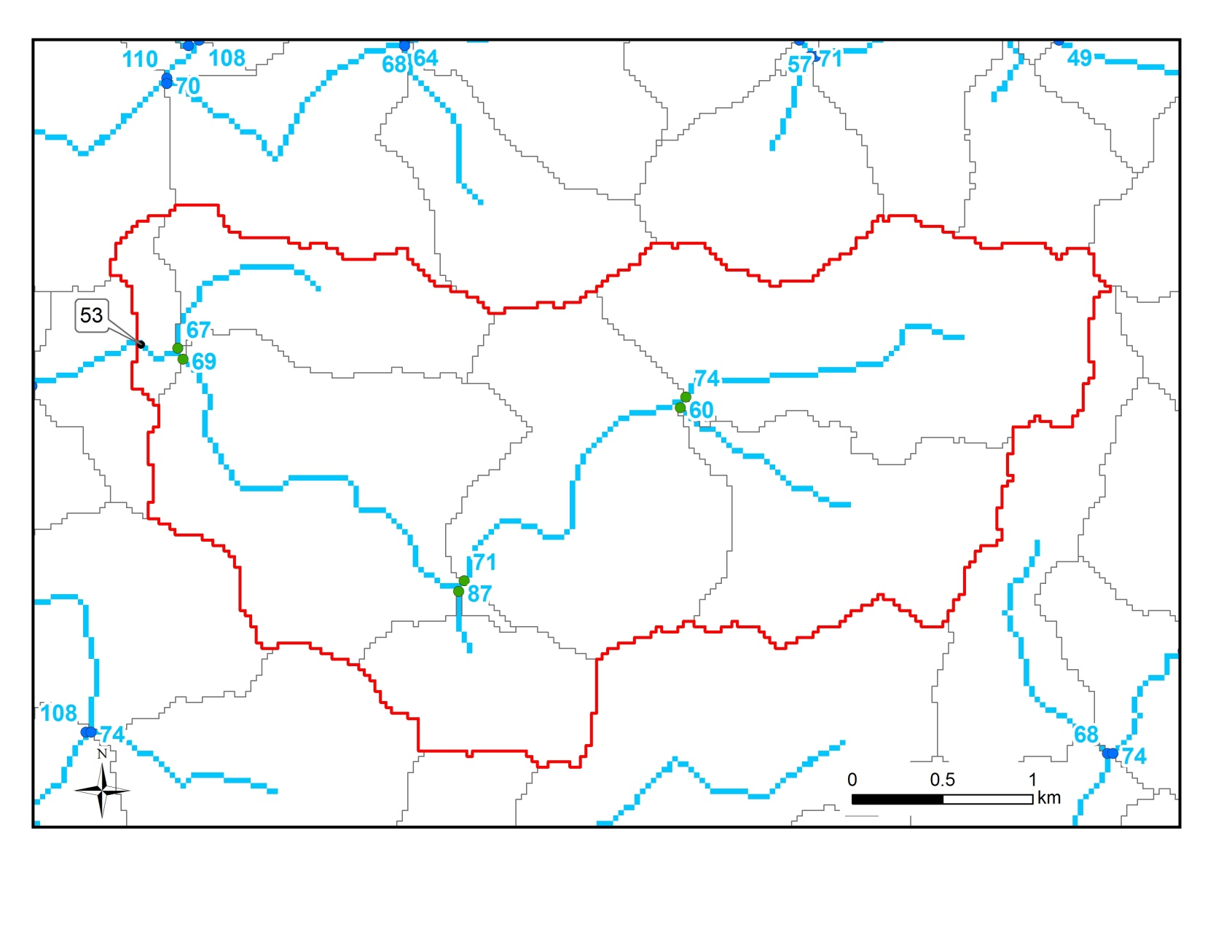
Predicted ANC

Slide 25
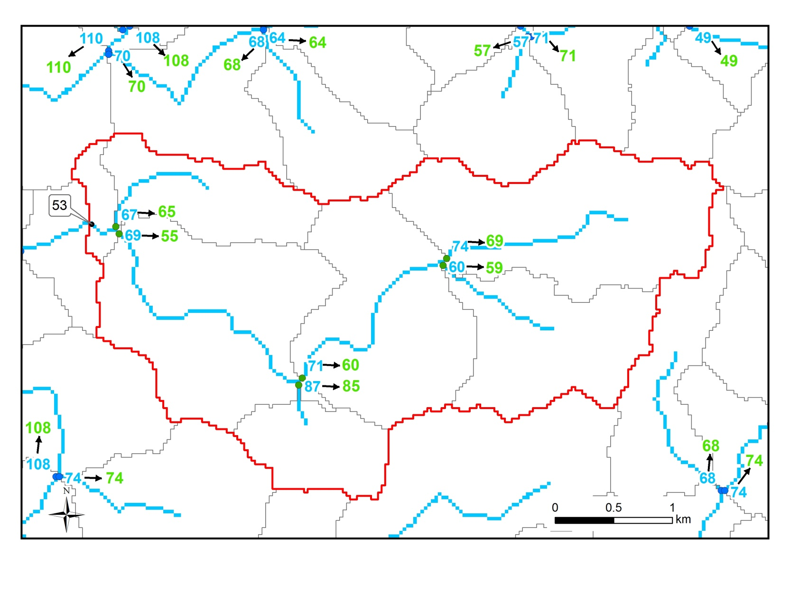
Drainage Area-Weighted Average ANC

Slide 26
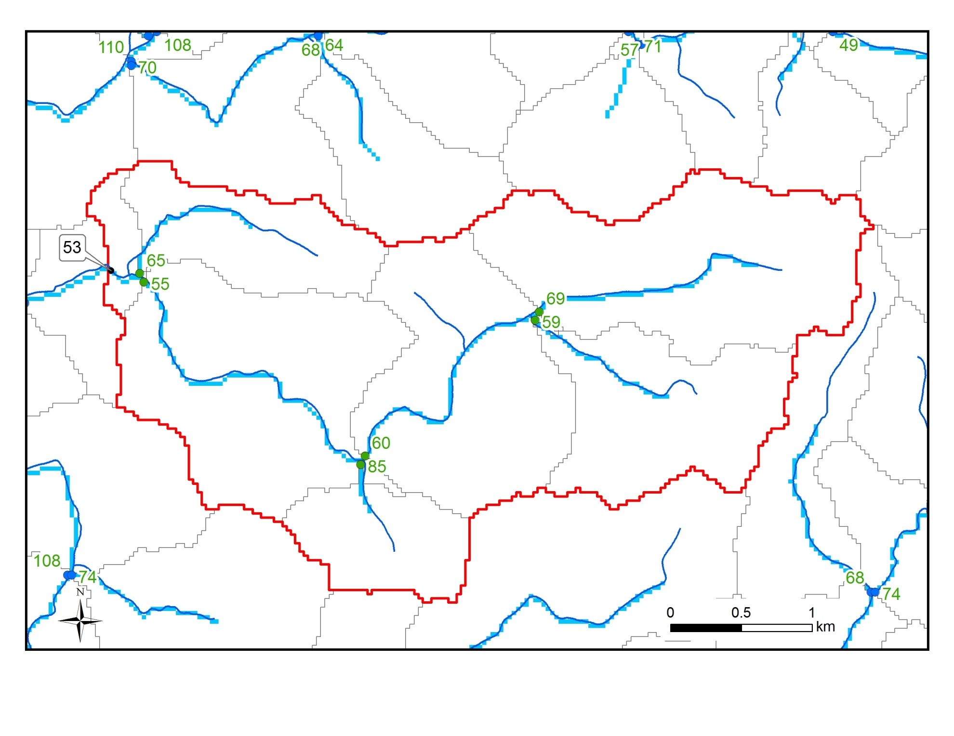
Attribute ANC to NHD Streams

Slide 27
Sulfur Critical Loads - SSWC
CL(S) = BC_{w} + BC_{dep} – Bc_{up} – ANC_{limit}
BC_{w} – three methods
BC_{dep} – NADP (wet) + Dry:Wet (dry)
Bc_{up} – USFS National Terrestrial CLs (McNulty et al. 2007)
ANC_{limit} – ANC = 50 and 100 * Runoff

Slide 28
BCw Methods
Type | Method | Percent of Study Region | Average Standard Deviation* (meq/m²/yr)
Statistical | Landscape Data | 100% | 39
Statistical | Water Chemistry | 9% 6.5% (low-anc) | 33 16
Process | MAGIC | 1% | 4
*For the statistical models the Std Dev is determined from 1,000 predictions made from each individual regression tree. Std Dev from MAGIC is determined from the number of successful calibrations (typically 10).
BC_{w} is averaged in the same manner as ANC for locations within water chemistry/MAGIC watersheds

Slide 29
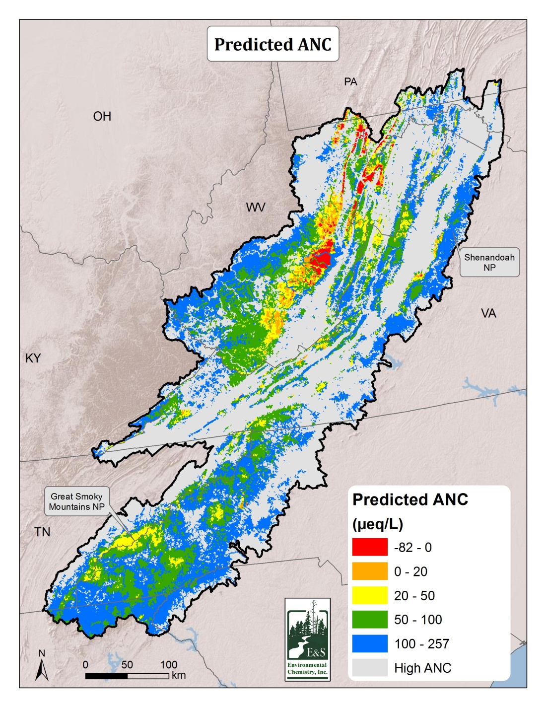
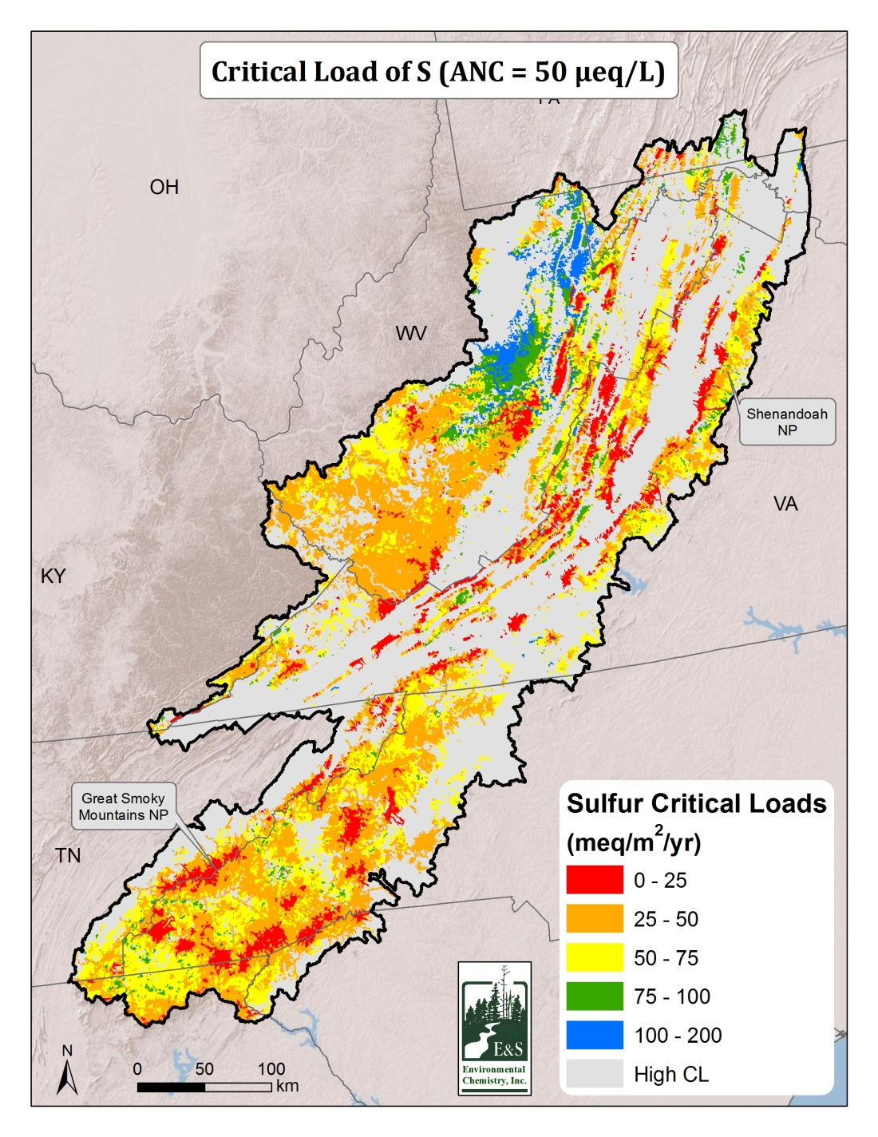

Slide 30
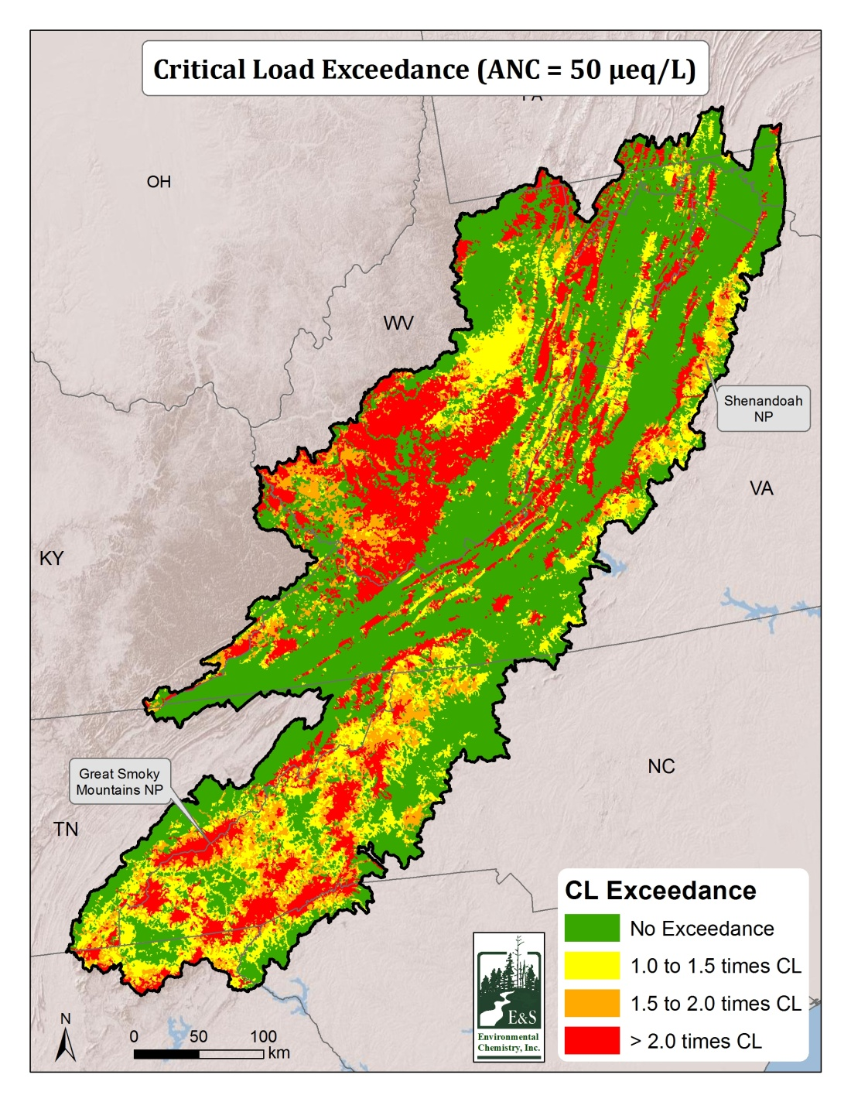
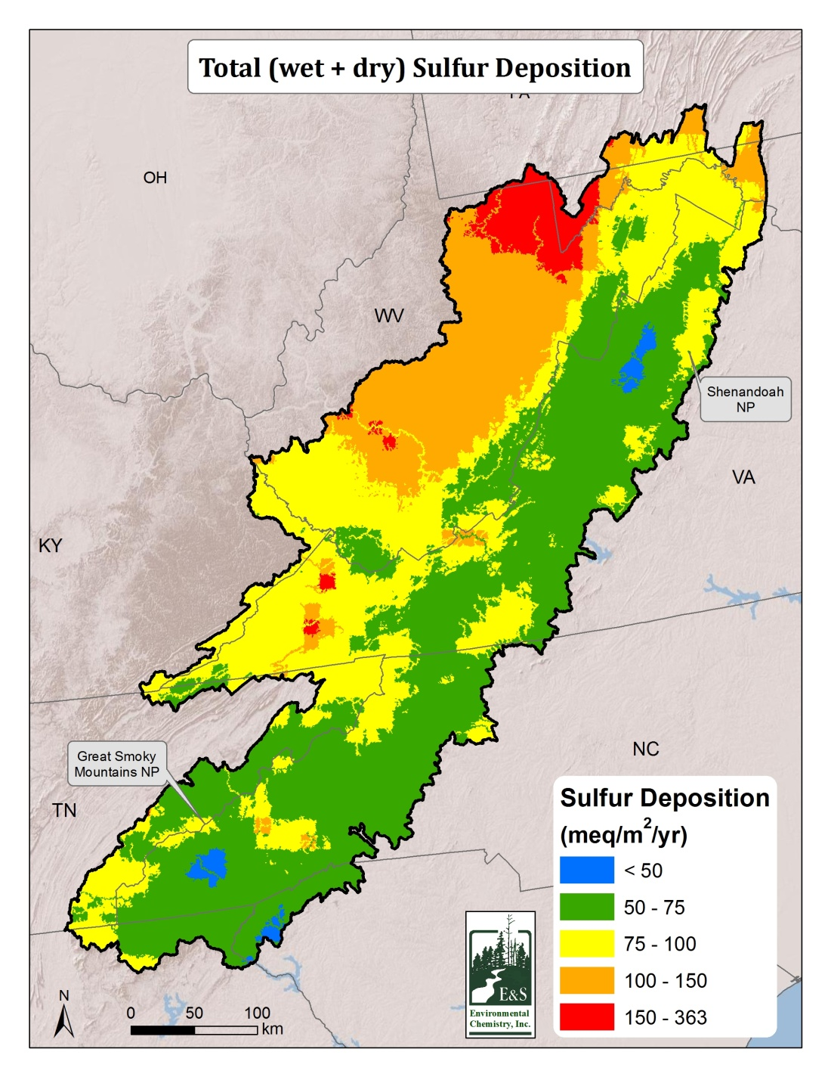
Notes:
EMDS contains a parameter to adjust sulfur deposition to simulate CL exceedance under different emissions reduction strategies

Slide 31
Logic to assess aquatic impact

Slide 32
Evaluated logic for Great Smoky Mountain National Park

Slide 33
Uncertainty in biological response

Slide 34
Uncertainty in exceedance ratio

Slide 35
Thank you
phessburg@fs.fed.us kreynolds@fs.fed.us

